Slide 1






SUITS AND
SNEAKERS
GAME
Suits And Sneakers Week is the most visible time for the Coaches vs. Cancer program during basketball season. Coaches from across the country wear sneakers with their suits at their games during this week to raise awareness and funds for the American Cancer Society. Team up with Coaches vs. Cancer and host a Suits And Sneakers game this season at your school or university!
ESTABLISHMENT OF PLANNING COMMITTEE
In an effort to maximize reach and engage students, faculty, fans and the community as a whole, each school should create a small, local organizing committee.
2019-2020 Coaches vs. Cancer Suits And Sneakers Game support childhood cancer research, services, and awareness, as well as promote cancer prevention.
*If your event has historically supported another American Cancer Society program, you may continue to do so. If your coach(es) prefer to support the full mission of the American Cancer Society, you may opt out of the restriction to childhood cancer.
THIS COMMITTEE WILL
RESPONSIBLE FOR THE FOLLOWING:
Creating the campaign utilizing provided marketing materials
Developing the event
activation plan
Fundraising
Setting local campaign goals
Implementing campaign initiatives
Spread messaging/awareness
to their respective groups/
organizations
Setting up online campaign at SuitsAndSneakers.org
GAME TIMING
Games can be scheduled any time during the season, but we encourage schools to plan their game in conjunction with Suits And Sneakers Week, January 20-26, 2020, where feasible.
MAKING PROGRESS TOGETHER
,

Slide 2
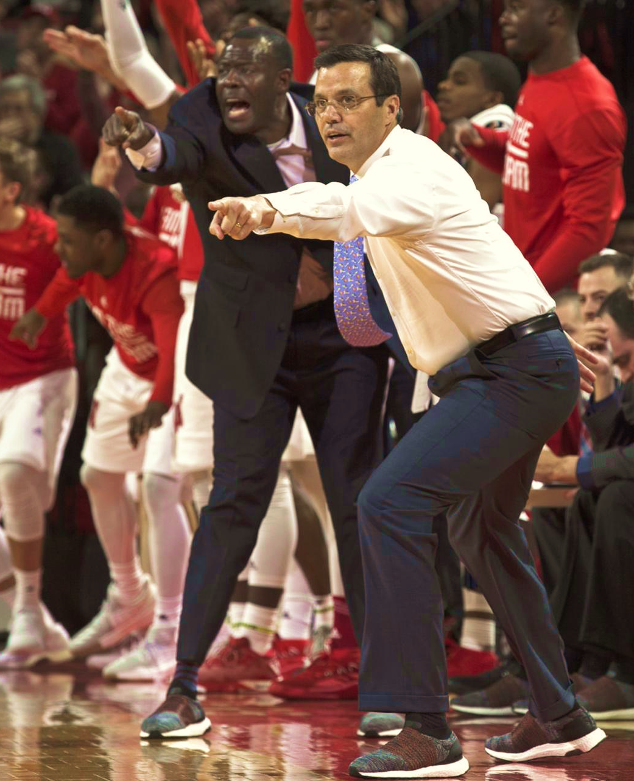
FUNDRAISING COMPONENT:
Each game should have a fundraising component to generate much-needed funds for the American Cancer Society. Funds can be raised in several ways by your school through online or offline channels.
GAME FUNDRAISING ELEMENTS COULD INCLUDE THE FOLLOWING:
Set up your game online at SuitsAndSneakers.org and invite fans/parents to make donations prior/during/after the game.
Collect cash donations at half-time during a pass the bucket or miracle minute challenge.
Sell pin-ups for fans to sign to post on the wall of the school or arena.
Run an In-game 50/50 raffle facilitated by ACS and presenting partner volunteers.
Hold a Relay for Life event on campus the morning of
the game, where student organizations and/or members of the community form teams and compete to raise money.
Create a sponsored, limited edition game souvenir cup that fans can purchase for an additional cost (their donation) at concession stands.
Host a VIP party with a giveback to Coaches vs. Cancer.
Implement a “round up” option for in-game purchases at concession stands.
Include a “shoot down cancer” element during halftime or post game.
Incorporate gold or another color into your game by offering Coaches vs. Cancer T-Shirts or shoelaces for presale.
Hold a “bling-out sneakers” contest where students can decorate sneakers and take donations as votes for the best pair.
AWARENESS COMPONENT:
IN-GAME MOMENT
To create a powerful awareness moment, each fan should be given a “Today, I Honor...” card as they enter the game. Fans will be able to honor loved ones by writing the name of someone affected by cancer on their cards.
During a timeout, all fans will hold up their plaques, with Coaches vs. Cancer audio or video messaging, encouraging fights to take action and stand in unity in the fight against cancer.
SUITS AND SNEAKERS AUCTION
Suits And Sneakers Auctions can be hosted through online or offline platforms, running for approximately 2 weeks prior to the event.
Auction items could include the following:
Player jerseys (plus custom warm-up shirts with
winning bidder’s name printed on back)
Signed shoes
Coaches’ signed sneakers, ties, and other wearables
Signed basketballs
Framed posters
Game nets
Autographed memorabilia from school legends and
hall of famers
Unique fan experiences (lunch with Coach, tour of
facilities, ticket packages, hospitality events, etc.)
For more information please contact: SuitsAndSneakers.org
coachesvscancer@cancer.org

